Slide 1
Session 4: Phase 2 lobotime training
PREPARED BY Arielle slone, Sr hr consultant
Emily Luhman, deputy chro

Slide 2
Agenda
Org Manager Expectations
Best Practice for Pay Period Review
Org Manager Experience
  Creating a Hyperfind
  Manage Timecard Tile
  Common Dataviews
    Time Off Request Info
    Sign Off Status
  Timecard Sign Off
  Other Dataviews
    Overtime Summary

Slide 3
Meeting Protocol
Limit questions to the content being presented
Questions should be submitted via chat
  For questions that can be answered via the chat, LoboTime Team members will respond
Do not unmute to ask a question during the presentation
Tuesday Drop-in Session will address questions during training session
Weekly Recap will summarize training content and questions
Meetings will be recorded and posted on https://time.unm.edu/

Slide 4
Phase 2 Training Objective
After completion of Phase 2 LoboTime Training, you should understand:
  Employee, Supervisor, and Org Manager roles
  Expectations for Org Managers
  Basic System Functionality
  LoboTime Support Resources
Demonstrations of LoboTime functionality progressing from basic to advanced

Slide 5
LoboTime Workflow
Employee
Clock In/Out
Review & Approves Timesheet
Supervisor
Reviews Timecard for Accuracy
Approves Timecard
Org Manager
System Support
Final Sign Off
Escalate Complex Issues
Submits Leave
Approves Leave Requests
Ensure timecards and complete & approved
Notes:
Standard Practice: Work for most, not all
Complex Departments might deviate from standard practice
System is flexible: Can accommodate most department needs
Need support, contact time@unm.edu
Examples: Student employee supervisors, student employees who work for non-UNM employers, 24/7 departments, remote/rural work locations

Slide 6
Org Manager Experience

Slide 7
Org manager Expectation: Side-by-side comparison
Timekeeper | Time Approver
Current State: PHATIME | Current State: PHATIME
Ensure employees complete and submit paper timesheets each pay period. Reviews timesheet for accurate time reporting. Signs paper timesheet. Submits paper timesheet to timekeeper for entry into PHATIME. | Ensure employees complete electronic timesheet in LoboTime. Reviews timesheet for accurate time reporting. Approves employee’s timesheet in LoboTime.
Standard Expectations | Standard Expectations
Knowledge: Understanding of time and leave policies and department procedures. Responsibility: Ensure employees are working assigned work schedule. Responsibility: Hold employees accountable for following University and department time and leave requirements. Responsibility: Review and approve timesheets according to processing deadlines. Quality Control: Ensure employees are recording time worked accurately. Support: Provide training and direction to employees on time and leave requirements. | Knowledge: Understanding of time and leave policies and department procedures. Knowledge: Basic use of LoboTime to clock in/out, request leave, review and approve timesheet. Responsibility: Ensure employees are working assigned work schedule. Responsibility: Hold employees accountable for following University and department time and leave requirements. Responsibility: Review and approve timesheets according to processing deadlines. Quality Control: Ensure employees are recording time worked accurately. Support: Provide training and direction to employees on time and leave requirements.
Org Manager
Future State: LoboTime
Reviews timesheets to resolve time punch issues, leave usage errors and timesheet approvals. Reviews timesheets for compliance with UNM timekeeping policies and procedures. Reviews timesheets for Sign Off.
Standard Expectations
Knowledge: Understanding of time and leave policies and department procedures. Knowledge: Advanced use LoboTime to clock in/out, request leave, review and approve timesheet, and reporting. Responsibility: Communicates payroll processing deadlines and monitors submission of timesheets. Responsibility: Reviews and processes time entry according to processing deadlines. Quality Control: Ensures time sheets are completed and approved consistent with University policy. Quality Control: Accurate data entry of timecards. Support: Provide support to employees and supervisors regarding University and department time and leave requirements. Support: Support employees and supervisors regarding use of LoboTime system.

Slide 8

LoboTime Access | Employee | Supervisor | Org Manager
Level of Access | Self | All subordinate employees | All employees within assigned dept
Punch or enter time for shift start, breaks and shift end
Edit timecards
Request time off
Edit or cancel time-off requests
Approve timecard
Delegate timecard approval
Build/Maintain Schedules
Approve Employee Timecards
Review alerts when employees deviate from the schedule
Run reports and analyze Dataviews
Final sign off of timecards

Slide 9
Approval Expectations: Best Practice
Best Practice:
  Employee maintains, resolves standard time and leave errors, approves timecard
  Supervisor reviews timecard for accuracy, maintains department pay rules (if applicable), approves timecard
  Org manager reviews timecards for error resolution, maintains complex pay rules (if applicable), submits for final processing
Approval back-up should occur within supervisor chain of command. Department practice can vary based on complexity and department structure.

Slide 10

Lifecyle of a Pay Period

Slide 11
Standard Review Process
Example:
Non-exempt employee
Works M-F
Best practice is for supervisor to review and approve timecard.
Best practice is for Org Manager to review timecards for errors and monitor approvals.
Week 1: Fri
Employee: Clock In/Out; Reviews Timecard; Corrects Errors
Week 1: Thurs
Week 1: Tues
Org Manager: Reviews Timecards for errors
Week 1: Mon
Employee: Clock In/Out; Reviews Timecard; Corrects Errors
Employee: Calls In Sick; Requests Sick Leave
Supervisor: Reviews Timecards; Approves Corrections; Approves Leave
Employee: Clock In/Out; Reviews Timecard; Corrects Errors
Employee: Clock In/Out
Week 1: Wed
Week 2: Mon
Employee: Clock In/Out; Reviews Timecard; Corrects Errors
Supervisor: Reviews Timecards; Approves Corrections; Approves Leave
Week 2: Tues
Week 2: Wed
Week 2: Thurs
Week 2: Fri
Employee: Clock In/Out; Reviews Timecard; Corrects Errors
Employee: Clock In/Out; Reviews Timecard; Corrects Errors
Employee: Clock In/Out; Reviews Timecard; Corrects Errors
Employee: Clock In/Out; Approves Timecard
Org Manager: Reviews Timecards for errors
Payroll Deadline: Mon
Supervisor: Reviews/Approves Timecard
Org Manager: Reviews Timecard for errors; Reviews approval; Final Sign Off
Supervisor: Reviews Timecards; Approves Corrections; Approves Leave

Slide 12

Non-Exempt Pay Period Close: Best Practice
Goal: Review timecards for errors, compliance with policy and department pay rules, and sign off on complete timecards.
Non-Exempt Pay Period Close Steps
Step 1: Review for any punch corrections (Manage Timecard Tile)
Step 2: Review for any pending leave requests (Time Off Request Info Dataview)
Step 3: Review individual timecards for special needs or department pay rules
Ex. FMLA Leave, CAT Leave, Paid Leave Types, Comp Time
Step 4: Review timecards for required approvals
Step 5: Sign Off

Slide 13

Exempt Pay Period Close: Best Practice
Goal: Review timecards for errors, compliance with policy and department pay rules, and sign off on complete timecards.
Exempt Pay Period Close Steps
Step 1: Review for any pending leave requests (Time Off Request Info Dataview)
Step 2: Review individual timecards for special needs
Ex. FMLA Leave, Paid Leave Types
Step 3: Review timecards for required approvals
Step 4: Sign Off

Slide 14
Demonstration

Slide 15

Test Scenarios
Create realistic timecards
  Enter timecards from previous pay period
Approve timecards
Access Dataviews
  Time Off Request Info
  Sign Off Status
Navigate within the dataview
Sign Off

Slide 16
What comes next…
Additional Questions and Content Review
Weekly Recap Email
Tuesday Phase 2 Drop-In Sessions (January 13th)
Phase 2 Training Session 5 January 16th 11:00 – 12:00
  Supervisor and Employee Training
  Employee Schedules
    When to use schedules
    Creating a schedule
    Schedule management
    Mass index transfer

Slide 17
Implementation Timeline
January Milestones
Finalize and Communicate Department Timekeeping Procedures
Continue to communicate and reinforce LoboTime training for employees and supervisors
Confirm Expectations for Org Managers
Supervisor and Employee User Acceptance Training
See Phase 2 Readiness Checklist (https://time.unm.edu/resources/lobotime-phase-2-checklist_final.pdf).

Slide 18
Future Work
Union Scenarios such as standby pay, call back pay, shift differential, etc.
Comp Time
Faculty supervisor support
Complex Leave Scenarios
Payroll Adjustments

Slide 19
Resources
Website: https://time.unm.edu/
Phase 2 Resources (https://time.unm.edu/resources/phase-two-resources.html)
  Implementation Checklist
  Job Aids **New**
  Department Procedure Guides
  Phase 2 Drop In Session: Tuesday, January 12th 11:00 – 12:00

Slide 20
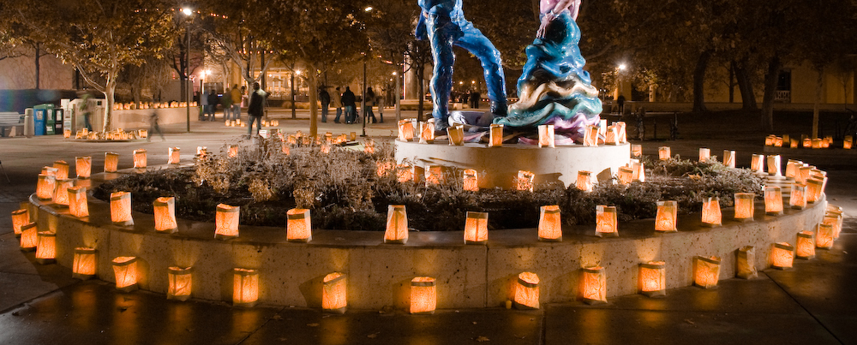
Additional Questions?
Contact the LoboTime Implementation Team at time@unm.edu

